Slide 1
OBJECT ORIENTED DESIGN AND PROGRAMMING
UNIT IV
Template & Exception Handling

Slide 2
Topics covered
Template
Introduction
Types
Function Template
Class Template
Example Program
Exception Handling
- try catch
- Multilevel exceptional
- throw and throws
- user defined exceptional
- Example program

Slide 3
TEMPLATE
Definition :
A template is a blueprint or formula for creating a generic class or a function.
Involves writing code in a way that is independent of any particular type
you can create a single function or a class to work with different data types using templates.

Slide 4
How templates work?
Templates are expanded at compiler time. This is like macros. The difference is, compiler does type checking before template expansion.
The idea is simple, source code contains only function/class, but compiled code may contain multiple copies of same function/class.

Slide 5
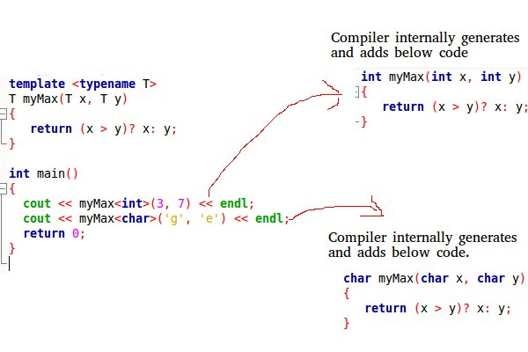
Example Program

Slide 6
Template - Types
a. Function Template
A function template can work with different data types at once.
Declaration
A function template starts with the keyword template followed by template parameter/s inside < > which is followed by function declaration.
template <class type>
ret-type func-name(parameter list)//fn declaration
{ // body of function }

Slide 7
Example – Function Template
#include <iostream>
using namespace std;
template <typename T>
T myMax(T x, T y)
{ return (x > y)? x: y; }
int main()
{
cout << myMax<int>(3, 7) << endl; // Call myMax for int
cout << myMax<double>(3.0, 7.0) << endl; // call myMax for double
cout << myMax<char>('g', 'e') << endl; // call myMax for char
return 0;
}
Output :
7
7.0
g

Slide 8
Program to swap data using function templates
#include <iostream>
using namespace std;
template <typename T>
void Swap(T &n1, T &n2)
{
T temp;
temp = n1;
n1 = n2;
n2 = temp;
}
int main()
{
int i1 = 1, i2 = 2;
float f1 = 1.1, f2 = 2.2;
char c1 = 'a', c2 = 'b';
cout << "Before passing data to function template.\n";
cout << "i1 = " << i1 << "\ni2 = " << i2;
cout << "\nf1 = " << f1 << "\nf2 = " << f2;
cout << "\nc1 = " << c1 << "\nc2 = " << c2;
Swap(i1, i2);
Swap(f1, f2);
Swap(c1, c2);
cout << "\n\nAfter passing data to function template.\n";
cout << "i1 = " << i1 << "\ni2 = " << i2;
cout << "\nf1 = " << f1 << "\nf2 = " << f2;
cout << "\nc1 = " << c1 << "\nc2 = " << c2;
return 0;
}
Output
Before passing data
i1 = 1 i2 = 2
f1 = 1.1 f2 = 2.2
c1 = a c2 = b
After passing data
i1 = 2 i2 = 1
f1 = 2.2 f2 = 1.1
c1 = b c2 = a

Slide 9
Template - Types
b. Class Template
Class templates are useful when a class defines something that is independent of the data type
Declaration :
template <class type>
class class-name
{
. . .
};
How to create object for Class?
className<dataType> classObject;

Slide 10
Example – Declaration & Object Creation
Declaration
template <class T>
class mypair
{ T values [2];
public:
mypair (T first, T second)
{
values[0]=first;
values[1]=second;
}
};
Object Creation
to store two integer
mypair<int> myobject (115, 36);
to store two floats
mypair<double> myfloats (3.0, 2.18);

Slide 11
Program to find the biggest among two elements using Class Template
#include <iostream> using namespace std; template <class T>
class mypair
{ T a, b;
public:
mypair (T first, T second) {a=first; b=second;}
T getmax ();
};
template <class T>
T mypair<T>::getmax ()
{ T retval;
retval = a>b? a : b; return retval; }
int main ()
{ mypair <int> myobject (100, 75);
cout << myobject.getmax(); return 0;
}
Output :
100

Slide 12
Multiple Arguments
#include<iostream>
using namespace std;
template<typename T, int size>
class set
{ T array[size];
public :
void getvalue()
{ cout<<“Enter array elements”;
for(int i=0;i<size;i++)
cin>>array[i];
}
void disp()
{ cout<<“Array elements are \n”;
for(int i=0;i<size;i++)
cout<<array[i];
}
};
int main()
{
set<int, 5> array1;
array1.getvalue();
array1.disp();
}
Output :
Enter array elements
22 25 28 31 35
Array elements are
22
25
28
31
35

Slide 13
Guess the output?
#include <iostream>
using namespace std;
template <typename T>
T max(T x, T y)
{
return (x > y)? x : y;
}
int main()
{
cout << max(3, 7) << std::endl;
cout << max(3.0, 7.0) << std::endl;
cout << max(3, 7.0) << std::endl;
return 0;
}

Slide 14
Exception Handling
Exceptions are run-time anomalies or abnormal conditions that a program encounters during its execution.
Specialized keywords for this purpose are
try: a block of code that can throw an exception.
catch: a block of code that is executed when a particular exception is thrown.
throw: Used to throw an exception. Also used to list the exceptions that a function throws, but doesn’t handle itself.

Slide 15
Syntax & Example
#include <iostream>
using namespace std;
int main ()
{
try
{
throw 20;
}
catch (int e)
{
cout << "An exception occurred. Exception Nr. " << e << '\n'; }
return 0;
}
Output:
An exception occurred. Exception Nr. 20
try
{
//code throw parameter;
}
catch(exceptionname ex)
{
//code to handle exception
}

Slide 16
Multiple catch blocks – To handle different types of exceptions
#include <iostream> #include<conio.h>
using namespace std;
int main()
{
int x[3] = {-1,2};
for(int i=0; i<2; i++)
{
int ex = x[i];
try
{
if (ex > 0) // throwing numeric value as exception
throw ex;
else // throwing a character as exception
throw 'ex';
}
catch (int ex) // to catch numeric exceptions
{
cout << "Integer exception\n";
}
catch (char ex) // to catch character/string exceptions
{
cout << "Character exception\n";
}
}
}
Output:
Integer exception
Character exception

Slide 17
Generalized catch block
#include <iostream> #include<conio.h>
using namespace std;
int main()
{ int x[3] = {-1,2};
for(int i=0; i<2; i++)
{ int ex=x[i];
try
{
if (ex > 0)
throw ex;
else
throw 'ex';
}
// generalised catch block
catch (...)
{
cout << "Special exception\n";
}
}
return 0;
}
Output :
Special exception
Special exception

Slide 18
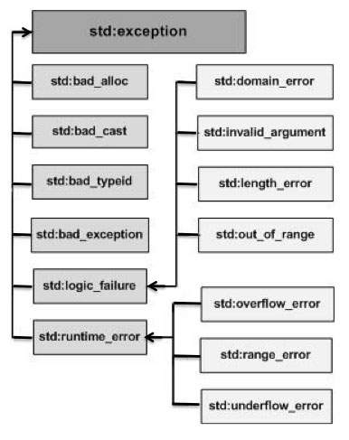
Standard Exceptions

Slide 19
Standard Exceptions- meaning
Sr.No Exception & Description
1 std::exception
An exception and parent class of all the standard C++ exceptions.
2 std::bad_alloc
This can be thrown by new.
3 std::bad_cast
This can be thrown by dynamic_cast.
4 std::bad_exception
This is useful device to handle unexpected exceptions in a C++ program.
5 std::bad_typeid
This can be thrown by typeid.

Slide 20
Standard Exceptions- meaning
Sr.No Exception & Description
6. std::logic_error
An exception that theoretically can be detected by reading the code.
7 std::domain_error
This is an exception thrown when a mathematically invalid domain is used.
8 std::invalid_argument
This is thrown due to invalid arguments.
9 std::length_error
This is thrown when a too big std::string is created.
10 std::out_of_range
This can be thrown by the 'at' method, for example a std::vector and std::bitset<>::operator[]().

Slide 21
Standard Exceptions- meaning
Sr. No Exception & Description
11 std::runtime_error
An exception that theoretically cannot be detected by reading the code.
12 std::overflow_error
This is thrown if a mathematical overflow occurs.
13 std::range_error
This is occurred when you try to store a value which is out of range.
14 std::underflow_error
This is thrown if a mathematical underflow occurs.

Slide 22
Advantages of Exception Handling
1). Remove error-handling code from the software's main line of code.
2) A method writer can chose to handle certain exceptions and delegate others to the caller.
3) An exception that occurs in a function can be handled anywhere in the function call stack.

Slide 23
User defined Exceptions
#include <iostream>
#include <exception>
using namespace std;
struct MyException : public exception
{ const char* what() const throw ()
{ return "C++ Exception"; }
};
int main()
{
try
{
throw MyException();
}
catch(MyException& e)
{
cout << "MyException caught" << endl;
cout << e.what() <<endl;
}
catch(std::exception& e)
{
//Other errors
}
}
Output :
MyException caught
C++ Exception

Slide 24
What is the output?
#include <iostream>
using namespace std;
int main()
{
int x = -1;
try {
cout << "Inside try \n";
if (x < 0)
{
throw x;
cout << "After throw \n";
}
}
catch (int x )
{ cout << "Exception Caught \n"; }
cout << "After catch \n";
return 0;
}

Slide 25
What is the output?
#include<iostream>
using namespace std;
class Base {};
class Derived: public Base {};
int main()
{
Derived d;
try {
throw d;
}
catch(Base b) {
cout<<"Caught Base Exception";
}
catch(Derived d) {
cout<<"Caught Derived Exception";
}
return 0;
}

Slide 26
What is the output?
#include <iostream>
using namespace std;
int main()
{
try
{
throw 'a';
}
catch (int param)
{ cout << "int exception\n"; }
catch (...)
{ cout << "default exception\n"; }
cout << "After Exception";
return 0;
}

Slide 27
UML dynamic Modeling (Behavior Diagram)
Objects are created and destroyed, objects send messages to one another in an orderly fashion, and in some system, external events trigger operations on certain objects.
Objects have states.
The state of an object would be difficult to capture in a static model.
In OOD dynamic modeling can be represented by following diagrams
Behavior Diagram
Sequence diagrams
Collaboration diagrams
State chart Diagram
Activity Diagram

Slide 28
Package Diagram
A package is a grouping of model elements.
Packages themselves may contain other packages.
Package may contain both subordinate packages and ordinary model elements.
The entire system can be thought of as a single high-level package with everything else in it.
All UML model elements and diagrams can be organized into packages.
A package is represented as a folder, shown as a large rectangle with a tab attached to its upper left corner.
If contents of the package are shown, then the name of the package may be placed on the tab.
The contents of the package are shown within large rectangle.

Slide 29
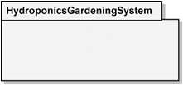
Essentials – Package diagram
Package Notation
Visibility of Elements
Public (+) Visible to elements within its containing package, including nested packages, and to external elements
Private (-) Visible only to elements within its containing package and to nested packages
Dependency Relationship
- - - - - - - - - - - - >

Slide 30
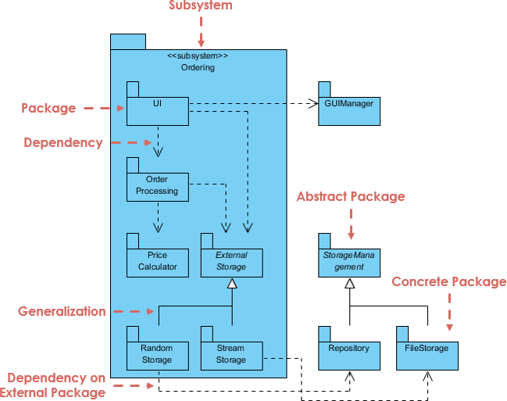
Package diagram Example - Order subsystem

Slide 31
import & access
import
import is a public package import where other elements that have visibility into the importing package can see the imported items.
access
access is a private package import
when a package performs an access, no other elements can see those elements that have been added to the importing package’s namespace.
These items are private; they are not visible outside the package that performed the access

Slide 32
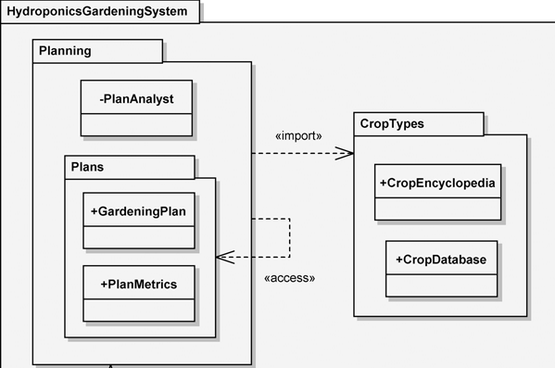
Example – import & access

Slide 33
Component diagram
It models the physical components(such as source code, executable program, user interface) in a design.
These high level physical components may or may not be equivalent to the many smaller components you use in the creation of your application.
Another way of looking at components is the concept of packages.
A package is used to show how you can group together classes, which in essence are smaller scale components.
package usually will be used to group logical components of the application, such as classes, and not necessarily physical components.

Slide 34
Essentials elements - Component Diagram
Component
Classifier rectangle in bold lettering
Component has port(denoted by small squares) with public/private visibility.
interface
shown in the ball-and-socket notation
Provided interfaces use the ball notation to specify the functionality provided by the component to its environment.
Required interfaces use the socket notation to specify the services required by the component from its environment

Slide 35
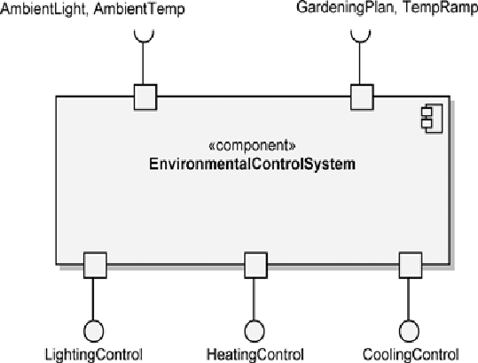
Component Notation

Slide 36
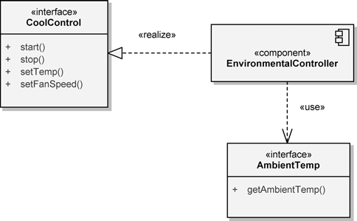
interface with dependency Notation

Slide 37
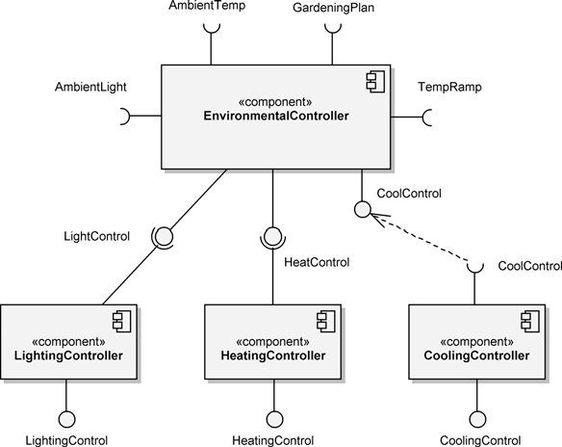
Component Diagram

Slide 38
Deployment Diagram
It show the configuration of run-time processing elements and the software components, processes, and objects that live in them.
Software component instances represent run-time manifestations of code units.
In most cases, component diagrams are used in conjunction with deployment diagrams to show how physical modules of code are distributed on various h/w platform
In many cases, component and deployment can be combined.

Slide 39
Deployment Diagram
A deployment diagram is a graph of nodes connected by communication association.
Nodes may contain component instances, which means that the component lives or runs at that node.
Components are connected to other components by dashed-arrow dependencies, usually through interfaces, which indicate one component uses the services of another.
Each node or processing element in the system is represented by a three-dimensional box.
Connections between the nodes themselves are shown by solid lines.

Slide 40
Essential elements
Artifacts
An artifact is a physical item that implements a portion of the software design. It is typically software code (executable ), but could also be a source file, a document, or another item related to the software code.
Artifacts may have relationships with other artifacts, such as a dependency or a composition.

Slide 41
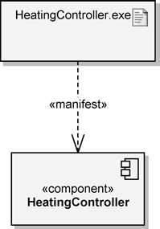
artifact Notation
Notation
The artifact notation consists of a class rectangle containing the name of the artifact, the keyword label «artifact», and an optional icon that looks like a sheet of paper with the top right-hand corner folded over

Slide 42
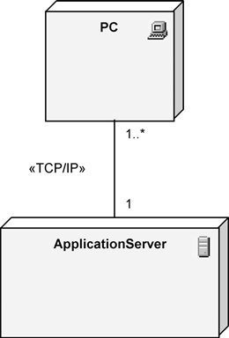
Node Notation
A node is a computational resource, typically containing memory and processing, on which artifacts are deployed for execution.
Types : 2 types
devices:
a piece of hardware that provides computational capabilities, such as a
computer, a modem, or a sensor.
Execution environment:
software that provides
for the deployment of specific types of executing artifacts

Slide 43
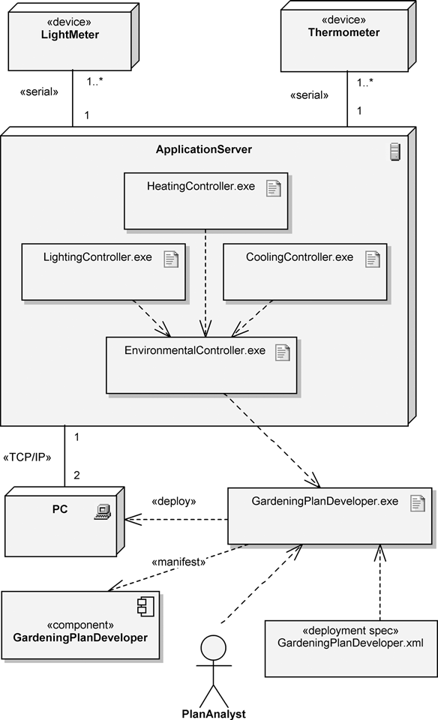
Deployment Diagram

Slide 44
Thank you

